Slide 1

ASSIGNMENT GUIDELINES
Make the changes in the PPT as you solve the parts
This file contains the template for the EDA part of the project.
Check the instructions added in the note section of every slide for clarity.
Don’t move around any image or text box
If you require more/lesser elements, be careful when you copy/delete the existing ones.

Slide 2
ASSIGNMENT Name: Aditya Singh Negi
Problem Statement
Bank of Corporate conducted a telemarketing campaign for one of its financial products, ‘Term deposits’, to build a long-term relationship with the existing customers. Your goal is to identify the target customers for the term deposits from the pool of the bank’s existing customers. You should also capture the key driving factors (or driver variables) behind the successful conversion of a customer, i.e., the customer opening a term deposit account with the bank.
Assignment Objective
To identify the target customers and the driving factors behind a successful customer conversion for future marketing campaigns.
Notes:
Problem Statement

Slide 3
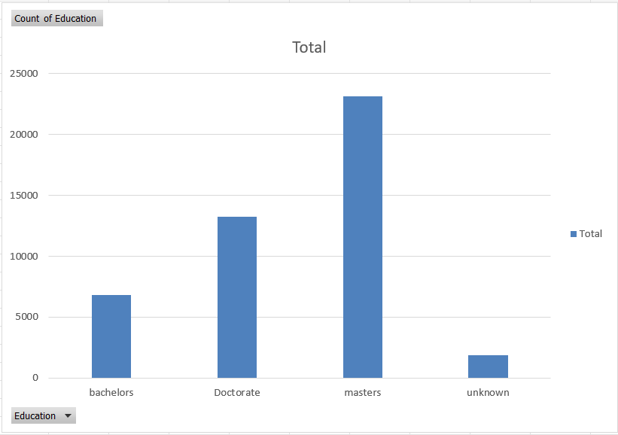
PART I : Univariate Analysis
Variable under consideration: Education level
Notes:
Mention the results of the excel analysis and add the corresponding visualisations to the space provided above. Use copies of the above slide if necessary.

Slide 4
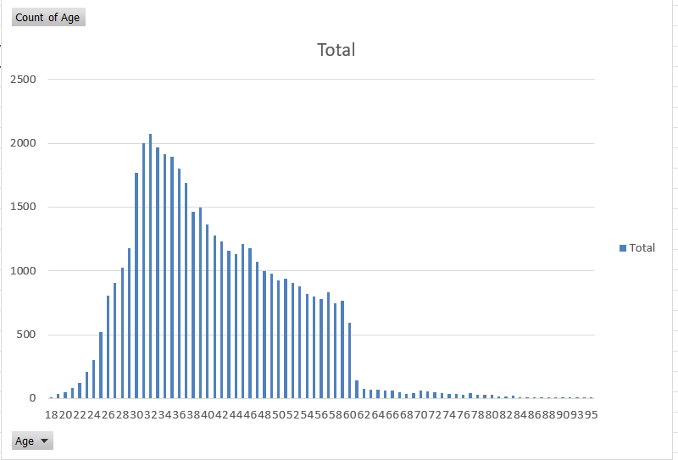
PART I : Univariate Analysis
Variable under consideration: Age of the Account Holder
Notes:
Mention the results of the excel analysis and add the corresponding visualisations to the space provided above. Use copies of the above slide if necessary.

Slide 5
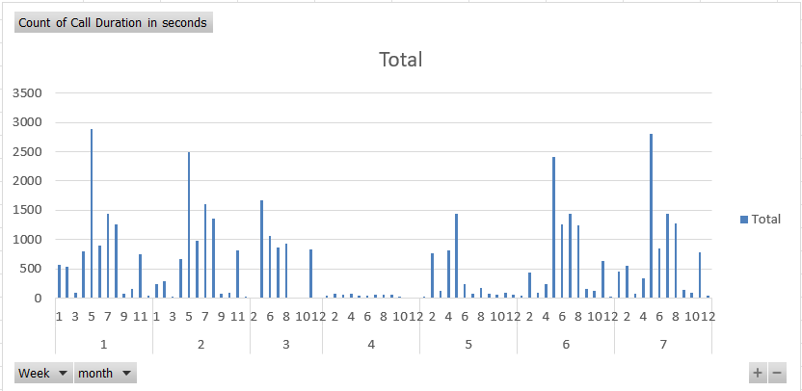
PART I : Univariate Analysis
Variable under consideration: call duration of customers in seconds
Notes:
Mention the results of the excel analysis and add the corresponding visualisations to the space provided above. Use copies of the above slide if necessary.

Slide 6
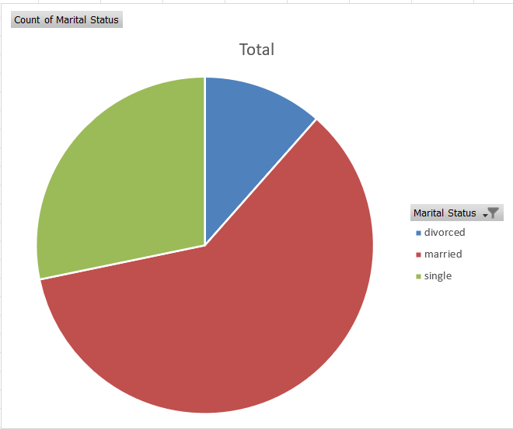
PART I : Univariate Analysis
Variable under consideration: Martial status
Notes:
Mention the results of the excel analysis and add the corresponding visualisations to the space provided above. Use copies of the above slide if necessary.

Slide 7
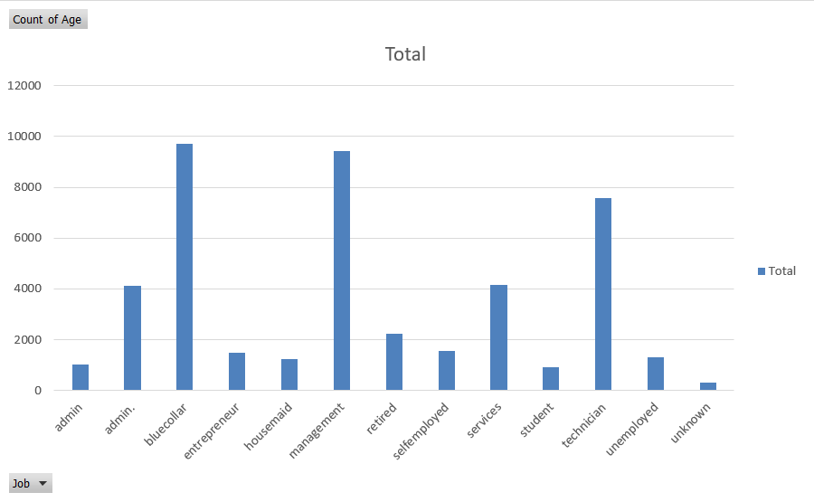
PART II : Bivariate Analysis
Variables under consideration: Age vs Job
Notes:
Mention the results of the excel analysis and add the corresponding visualisations to the space provided above. Use copies of the above slide if necessary.

Slide 8
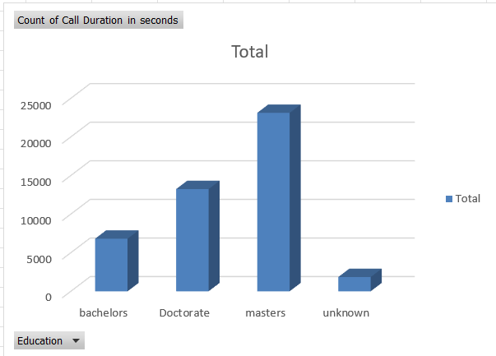
PART II : Bivariate Analysis
Variables under consideration: Education vs Call duration
Notes:
Mention the results of the excel analysis and add the corresponding visualisations to the space provided above. Use copies of the above slide if necessary.

Slide 9
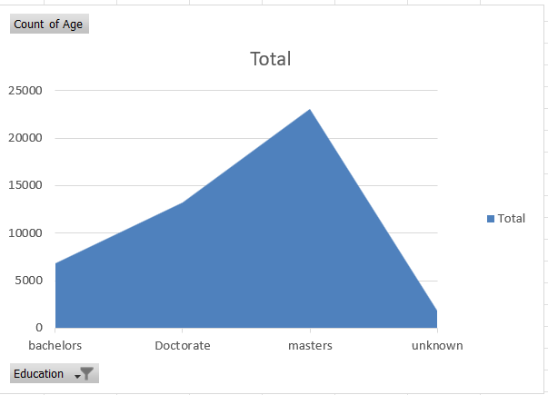
PART II : Bivariate Analysis
Variables under consideration: Age vs Education
Notes:
Mention the results of the excel analysis and add the corresponding visualisations to the space provided above. Use copies of the above slide if necessary.

Slide 10
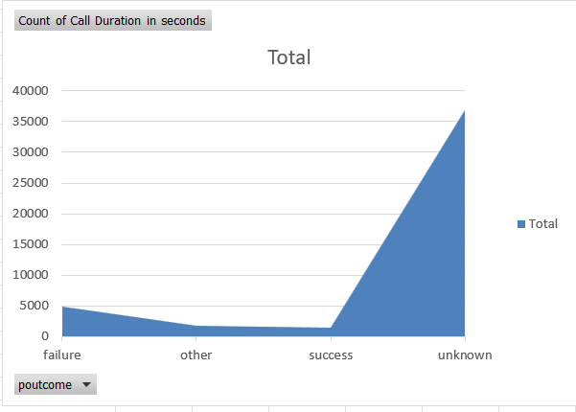
PART II : Bivariate Analysis
Variables under consideration: Call duration vs Contacted
Notes:
Mention the results of the excel analysis and add the corresponding visualisations to the space provided above. Use copies of the above slide if necessary.

Slide 11
PART IV: Major insights Marketing Campaign Optimisation
The average call duration for each successful term deposit is 10 minutes, so the cost is approx. Rs. 100for each conversion.
The segment with Masters and Married have the highest conversion rates hence this segment could be targeted.

